Slide 1

AHRQ Toolkit
The Harborview Experience
Ellen F. Robinson, PT
Manager, Clinical Quality Specialist
Seattle, WA

Slide 2
Objectives
Discuss utilization of the AHRQ Patient Safety Indicator (PSI) data to develop a high level enterprise measure of hospital quality
Provide examples of how to utilize the AHRQ Toolkit to operationalize PSI review
Discuss how to utilize PSI information to identify opportunities to improve patient care

Slide 3
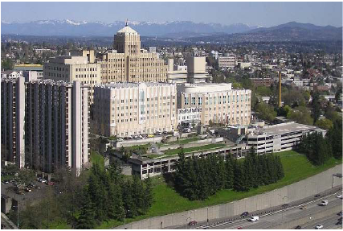
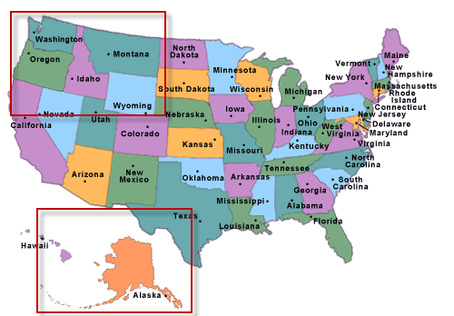
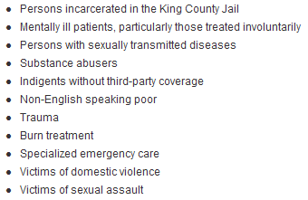

The Harborview Experience
WAMI REGION
Mission and Priority of care

Slide 4
The Steps
July 2011
PSI Project Full Integration
July 2010
AHRQ Toolkit Project
July 2009
Oh I wish I had a “toolkit”
July 2008
WHAT IS A PSI?
Notes:
Discuss my time frame and how I will go back between pre tool kit project and how we then got more momentum from this toolkit initiative

Slide 5


Where Are We Now?
2013
2012
2012 to 2014
Integrated a PSI Metric as a marker of Patient Safety
Spans the UW Medicine Enterprise:2 Academic Medical Centers & 2 Community Hospitals
Consistently reviewed at Board and Leadership Meetings
Notes:
Current state

Slide 6
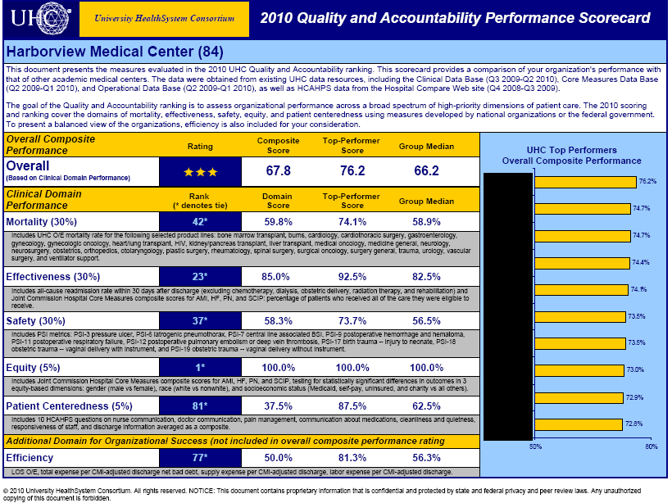
Quality Improvement Initiative
Two Goals
External Reporting
Internal Case Identification
Medical QI Committee (MQIC)
Departmental M&M review/report
Standard identification of potentially preventable harm events for clinical review
Tracking of outcomes of reviews for trending of possible opportunities
Notes:
Why we looked at PSI

Slide 7
Section A
Readiness for Change
IQI/PSI Fact Sheets
AHRQ Specification Guidelines
Readiness to Change (Self Assessment)
  Medical Director - previous director of QI Dept
  Leadership Support and directive for project
  The Board was “on board”
  Challenges identified: information dissemination about quality and patient safety to staff at all levels of the organization

Slide 8
Section B: Applying the Indicators to your hospital data
Utilizing UHC database to track rates for PSI
UHC Quarterly Summaries ~ 3 months behind
Individual Case review ~ 6 weeks behind
Too late to make an impact
How do we get PSI data in “real time”?
Can we use our internal data and the AHRQ software and get the same results?
Notes:
Sounds easy right? How long did this take to implement?

Slide 9
Data Challenges - Input
Internal Source System for data points (3M)
3M Report output= 2 pages, multiple Rows
PERL Script to transform into usable input file
AHRQ Software is free and easy to download, but each hospitals’ source system may be slightly different
IT Resources may be required for mapping

Slide 10
Data Challenges - Output
Validate Numerator and Denominator against publically reported values
Quality Improvement Projects
  Track each PSI cases individually for possible opportunities to improve care
**Version changes and updates
Notes:
How we use the information – note that Publicly reported information may utilize a different version (IE UHC, State reports)

Slide 11
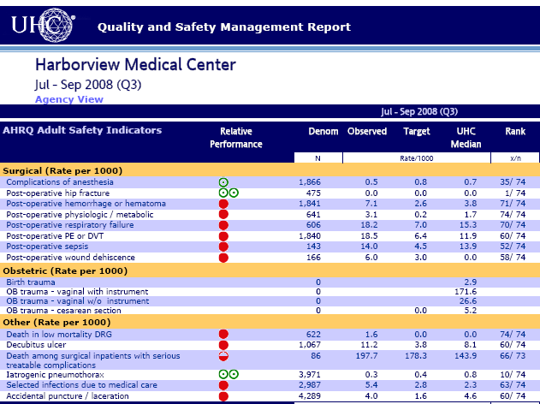
Section C: Identifying Priorities for Quality Improvement
HMC Project Originally utilized UHC as source
UHC runs the SAS version software on each hospitals administrative data set

Slide 12
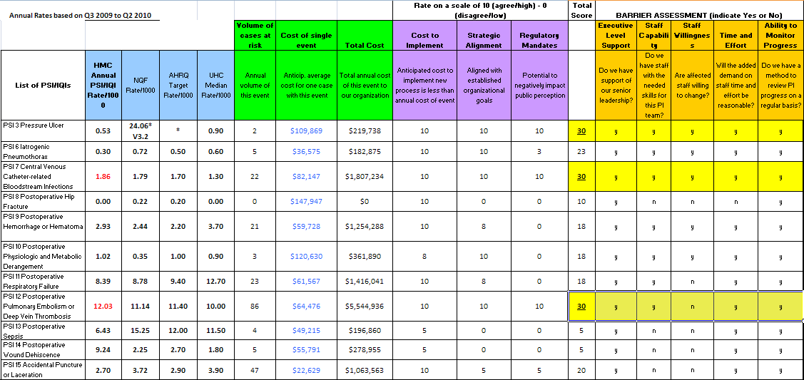
Prioritization Matrix
HMC Highest Prioritization scores: PSI 3 PSI 7 PSI 12
Have since focused on PSI 11 PSI 13 and PSI 15
Notes:
Can also utilize other figures to calculate – NHSN

Slide 13
Prioritization: Take it on the road!
Presented to Surgical Council, Medical Executive Board, Critical Care Council, Hospital Board, Clinical Documentation Specialists, Coding
  What are the PSIs?
  Why do we care?
  Current performance/UHC ranking
  How are we going to review/expectations from teams
  Possible opportunities for improvement
    Clinical areas
    Documentation -Coding
Notes:
Lots of concerns re: validity of indicators from clinical staff
Lots of concerns about coding updates from billing side
AGREEMENT: We will not send you “false” cases and you will review those events that we do send in a timely manner

Slide 14
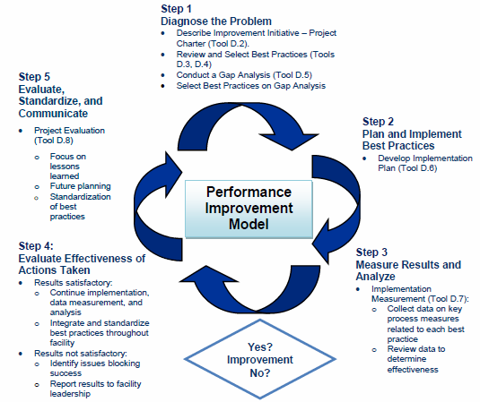
Section D: Implementing Improvement
Examples of effective PSI improvement strategies
Evidence-based best practices for selected PSIs
  Improvement Methods Overview
  Implementation Team Charter and Goals
  Selected Best Practices
  Gap Analysis
  Implementation Plan
  Implementation Measurement
Notes:
I am a PT background – starred items were very useful as a project manager as basic tools for QI project

Slide 15
Evidence-based best practices for PSIs
Forming Implementation Teams (“Task Forces”)
Who are the “experts” in these areas?
PSI 03: Clinical Nurse Specialists wound care
PSI 07: Infection Control
PSI 12: Anticoagulation Task force: Trauma Surgeon, Hospitalist, Pharmacy, Nursing
PSI 11: Spine Surgeon, Anesthesia, Respiratory
PSI 13: Sepsis Team: MD, CNS, Patient Safety
PSI 15: Surgeons, Clinical Document, Coding
Notes:
Great resources for starting out

Slide 16
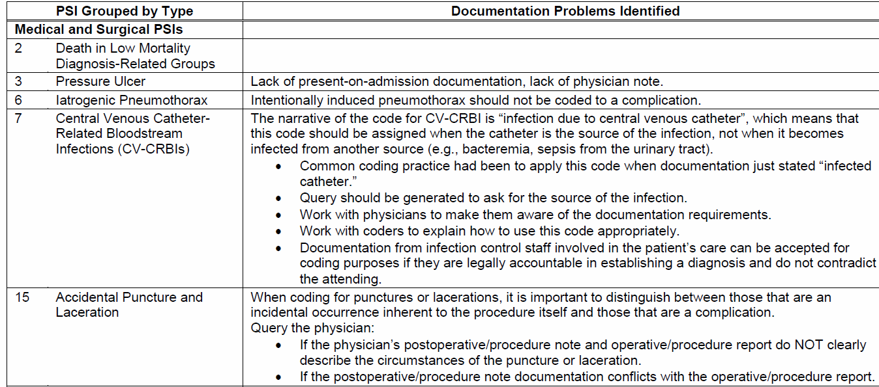
PSI Improvement Opportunities
Understand PSI Definitions
Consider how coding and documentation impact PSI rates
Validation of Event Cases
Consider specific populations
Notes:
Common issues for coding
Inclusions and exclusions
Make friends with your coders

Slide 17
Section E: Monitoring Progress and Improvement Sustainability
Run Input file through AHRQ Software 10 days after previous month for case identification
Upload PSI internal database to track outcomes
Providers report up through M&M conferences and Medical Quality Improvement Committee
Notes:
How we were going to tackle them – determine standards of care met or not and then refer and ask for MD team input

Slide 18
HMC PSI Case Review
AHRQ
Monthly Data Feed
No Event
No Coding Issue
Coding or
Documentation issue?
QI Analysis
Documentation Coding Review
Agree?
(Wrong code or exclusion criteria code missing)
Real Event?
Service Review
Update coding
QI Concerns
No QI Concerns
Notes:
Methods for PSI case review – Other hospitals in our enterprise run weekly or have Coding do first pass then send out to clinical teams

Slide 19
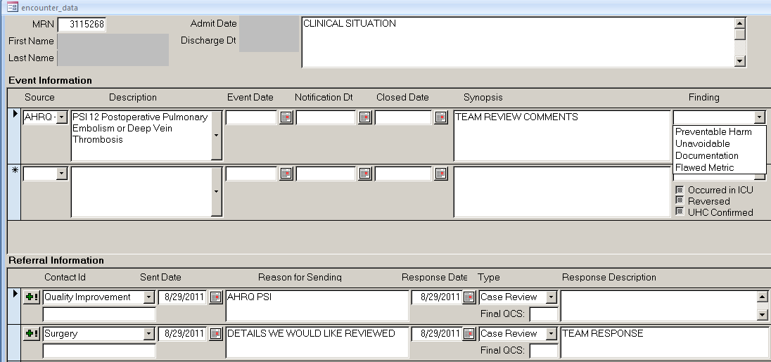
HMC Analysis and Tracking
Notes:
Numerator tracking

Slide 20
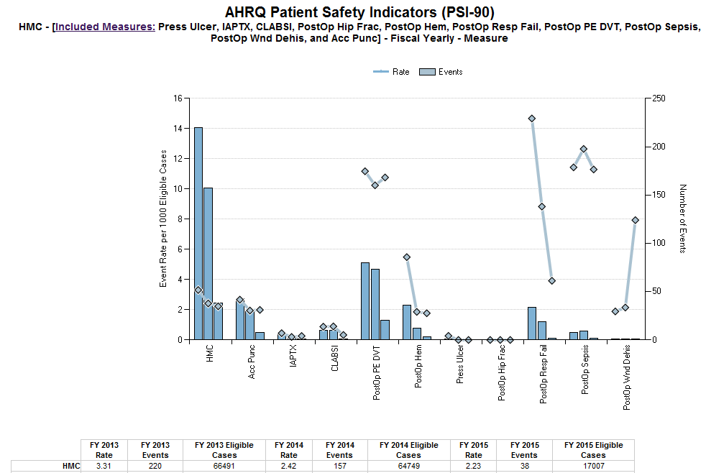
Monitoring Progress
High rate of PSI events = quality issue at a hospital?
Are all PSI events “preventable”?
* Web based tool for Quality Metrics reporting
Notes:
Web based tool allows for drill ins for time frame, specific events, rates – Leads us to another question…..

Slide 21
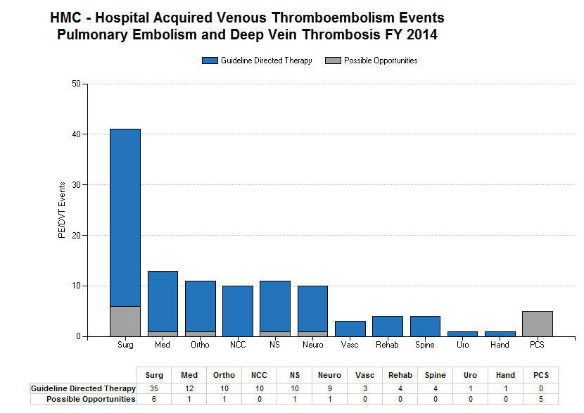
Finding Improvement Opportunities
  Review PSI 12 events – standard of care met?
    Compliance with UW Medicine guidelines for
        Prophylaxis Type?
        Prophylaxis Timing?
        Dose intensity?
        Mechanical when Chemical contraindicated?
Categorize Opportunities
Refer for further review as needed
Notes:
Can utilize process for any PSI category – come up with standard questions that all agree on
Review process of all VTE events in 1 month – takes (now) ~20-30 minutes – 8-10 cases
We can efficiently say that standard of care was met
What is more challenging is identifying when standard of care was not met – (variable practices if no evidence-based standards exist). These are sent on to QI reps for review.

Slide 22
Section F: Return on Investment
How can you measure the impact of PSI reduction?
UW Medicine Finance
Annual Process Review
Simple comparison to measure the impact of safety projects across the 4 hospital systems
Raw count differential X $$ = cost savings
Greatly valued by executive team
Notes:
Recent tool for CLABSI by John Hopkins – Opportunity Estimator – published Joint Commission Journal on Quality and Patient Safety

Slide 23
Section G: Existing QI Resources
Reviewed by our Research Librarian
Incorporated into University of Washington Health Sciences LibGuides web page
  Healthcare Quality News
  Pub Med Searches (preselected QI topics)
  eJournals related to quality and safety
  PubMed Notifications for specific topics
  Measures – links to TJC, NQF, CMS, UHC, IHI, WSHA,
  Publishing/RefWorks/EndNote
http://libguides.hsl.washington.edu/qualitysafety

Slide 24
HMC PSI Project Lessons Learned
Validate, validate, validate…………
Leadership backing for project importance and accountability from providers
Presentations to clinical providers should focus on actual clinical events and outcomes
Coding department project lead/liaison with clinical documentation specialists involvement
Customize task forces to address specific PSI categories and determine “preventability”
Notes:
Try to increase provider buy in with actual pt stories
Use coder to assist with analysis

Slide 25
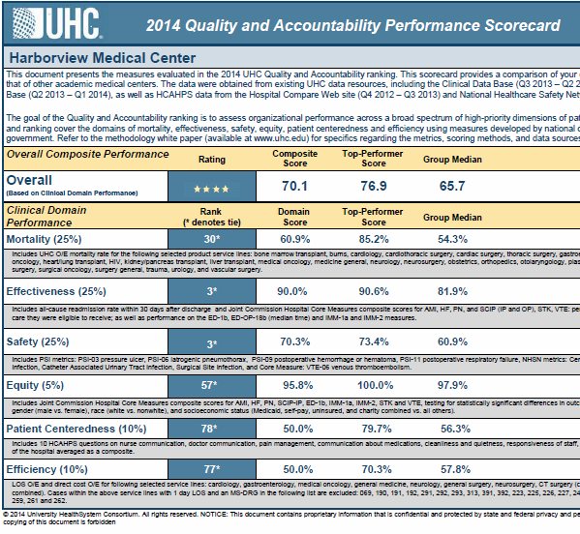
Thank You
Harborview Medical Center
Dr. J. Richard Goss
Dr. Anneliese Schleyer
Dr. Joseph Cuschieri
Ronald Pergamit, QI/IT
Derk Adams, QI/IT
Patty Calver QI
Ellen F. Robinson
(206) 744 9550
lnrobin@u.washington.edu

